Slide 1
Brink’s Complete Solution Kick-off
Revised August 27, 2020

Slide 2
Proprietary and Confidential
This document contains trade secrets or otherwise confidential information owned by Brink’s, Incorporated. Access to and use of this information is strictly limited and controlled. This document and the information contained herein may not be used, disclosed, or reproduced, in whole or in part, without prior written authorization.

Slide 3
Objectives
Review scope, and team
Align on key tasks within onboarding
Review next steps

Slide 4


Introducing
Brink’s Complete.
The brink’s solution
An all-in-one subscription service that
combines the best of Brink’s hardware,
software, and services. A turnkey solution engineered to make accepting cash easier and cheaper.
Fast & simple access to working capital
Streamlined cash handling operations
Reduced banking fees and cost of cash
Improved cash visibility
Reduced risk of internal & external theft
Notes:
Our solution secures physical cash deposits in a configurable hardware device in-store, integrates our 24SEVEN platform to digitize and process those deposits for faster access to working capital and to enable end-to-end visibility, and leverages Brink’s armored services to pick up and process physical cash.
Depending on the option selected, our solution can enable change orders to be shipped to your location.
Brink’s Complete adds value to your business by:
Eliminating constraints caused by manual cash handling.
Removing common pain points caused by traditional cash management solutions.

Slide 5


B-Safe
Brink’s Complete – Seizing the Opportunity
Subscription service reduces cost and simplifies cash management.
How it Works:
1
Brink’s places a low-cost device in locations.* Retailers pay a monthly subscription fee, based on cash volumes.
2
Retailers insert cash into device validators, use our 24SEVEN app to create and track deposits, request services and place change orders.
3
Deposits in the devices are credited to the retailers’ bank account of choice the next day.
4
Brink’s collects and processes the cash ~1x / Week CIT. Change orders are delivered via a third party service.
Brink’s Complete eliminates customer trips to the bank, improves employee safety, reduces losses and minimizes Brink’s stops in stores.
*Includes all hardware, software, services and next-day credit.
Notes:
ADDED VALUE
DMM
Forecasting Night Service
IBE
Vault optimization

Slide 6
Scope / Location Overview
Customer Implementation Lead:
Name: Francisco Rizo
Email: Francisco@Flwingmen.com
Phone: 786-357-9425
Locations:
Location Name | Street Address | City | St | Zip | Solution
Wingstop | 1703 East Commercial Blvd. | Fort Lauderdale | FL | 33334 | B-Safe
Scope:
Device: B-Safe
Change Orders Included?: Yes
Other?:
Brink’s Team – Project Coordination:
Name: Aaron Parker
Email: Aaron.Parker@brinksinc.com

Slide 7


Focus on Customer Success
Implementation: Focused resources, dedicated to end to end deployment
Training: Digital content, with additional customer-specific training as agreed upon
Customer Support: Online support available, managed by focused resources
Metrics & Analysis: Focus on KPIs and continuous improvement

Slide 8
Onboarding Tasks
Item
Registration & Onboarding
Complete End User provisioning & location set up
Send training materials
Confirm receipt of training materials
Send Welcome Kits
Install devices
Go Live
Go-live
Confirm first CIT pickup
Generate first monthly billing

Slide 9
Important Reminders – Installation
Reminders | Key Questions:
The following must be true: Install into concrete Location is clear of any obstruction, furniture, or legacy devices No water sources are within five feet of device location Power source is available within three feet Installation occurs on bottom floor Install can be done during open hours Note: Issues found with the above could delay, or cancel, your installation | Is an existing safe present? What area will we install in (back office, under counter, etc.)? Are there any other concerns?

Slide 10
Important Reminders – Welcome Kits
Description | Comments | Key Questions:
Welcome Kits mailed to each location ahead of install Contains: Brink’s Box: 25 deposit bags, QR code/link to training content B-Safe: 25 deposit bags, QR code/link to training content, one B-Safe liner (for installer), and two barcode badges Additional bags can be ordered in packs of 100 on (https://brinkssupplysource.nelmar.com/) | Ensure locations place kits in safe place | Are additional Kits, or Badges Needed?

Slide 11
Important Reminders – Change Orders
Description | Timing | Key Questions:
Subscription includes one change order/week Each order can be up to 20 lb, and $5K Orders are shipped via third party provider | Orders entered into 24SEVEN by 10 AM CST will be packed/shipped same day Orders will arrive within 2-3 days (depending on proximity to Memphis; delays may occur due to COVID-19) | Are there concerns with Order Size?

Slide 12
Important Reminders – ACH Direct Credit Posting
ACH Direct Credit Posting:
Deposit Cutoff Time | Processing Time to Retailer Bank
1 AM CST | Next business day, ~3-5 pm local time (larger banks typically post closer to noon)
ACH Report:
Description | Timing | Key Questions:
Standard direct credit ACH file provided each morning Sent via host-to-host connection, or email Encryption key provided | 8 am cst each business day | Who are the recipients of this report?

Slide 13
Important Reminders – 24SEVEN
Description | Key Questions:
Any user creating a digital deposit or a change order, or needing access to reports, or training material, will require 24SEVEN access 24SEVEN can be accessed via a smart device, or web | Are there concerns with user access?

Slide 14
Best Practices Review
Area | Best Practice
Overall implementation | Align main point-of-contact to partner with Brink’s to drive implementation Enable resource to serve as contact for locations, to facilitate decision-making, and to resolve issues, and to escalate items to Brink’s as needed
Training | Partner with Brink’s to define training strategy, and to deliver training content together to provide company policy and procedure changes along with product training
B-Safe Barcode Badges | Leverage Brink’s provided barcode badges Instruct locations to have designated space where badges are kept Order additional badges as needed through Brink’s Project Manager
Bag Ordering | Leverage 25 that comes within Welcome Kit Order (in packages of 100) through the Brink’s Supply Source (https://brinkssupplysource.nelmar.com/); allow up to one week for arrival
24SEVEN access | Provision users carefully Consider keeping Case Mgmt at Corporate level, versus all stores Consider having primary, and secondary, users that create change orders versus having multiple people

Slide 15
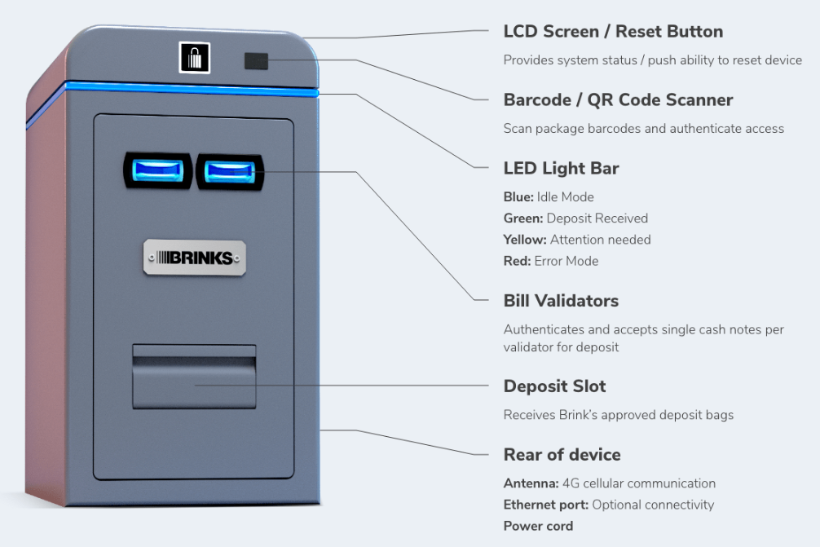
Tech-Enabled Devices: B-Safe
Note capacity | Up to 4000 notes
Validation | Dual single note validators + barcode
Dimensions H x W x D | Height: 27” Width: 12” Depth: 18”
Weight | 172 lbs

Slide 16
Key Next Steps
Validate locations
Confirm store processes
Align on training approach
Validate .01 test
Provision users
Schedule installs
Go live
Monitor transactions

Slide 17
Appendix

Slide 18
Brink's Direct Credit
Brink’s Direct Credit, powered by Brink’s Capital, uses technology to unlock capital to fund next day credit via ACH
How:
      Technology uses chain of custody to track assets; deposits are enabled for direct credit when physical cash is in device, and digital deposit exists in 24SEVEN
      Compliance program meets critical regulatory requirements
      Customer Benefits:
      Next-day access to cash to maximize working capital
      Consolidate banking relationships and quickly change banking partners
      Significant reduction in bank fees
      Quicker and less cumbersome onboarding process versus current daily credit solutions
      Hassle-free complete cash management solution from a single provider

Slide 19
Brink's Change Orders
Brink's Change Order service allows a customer to order change through the
24SEVEN app for delivery via third-party courier service
Third party courier service provides reasonable cost and predictable time period for delivery
      Add-on service, 4 change orders per month with subscription pricing
      Predictable SLA based on location and distance from mailing hub
      Orders are funded via Brink’s Capital
      Orders are packed out, and taken to mailing center for shipment
      Customers are ACH-debited change order total

Slide 20
Monthly Subscription Service
Brink's Complete enables a simple, hassle free subscription service
Brink’s Complete Subscription includes:
  Device
  Device CIT Service
  Enhanced Content Guarantee
  Device Maintenance
  Brink’s 24SEVEN
  Brink’s Direct Credit
  Device Delivery & Installation
Easy Monthly Subscription Billing

